Slide 1
SOLAR SYSTEM .. in a galaxy far far away.
Gaurav Bhatt gbhatt@iastate.edu
COM S 557

Slide 2
Agenda
Introduction
Techniques Used
Improvements

Slide 3
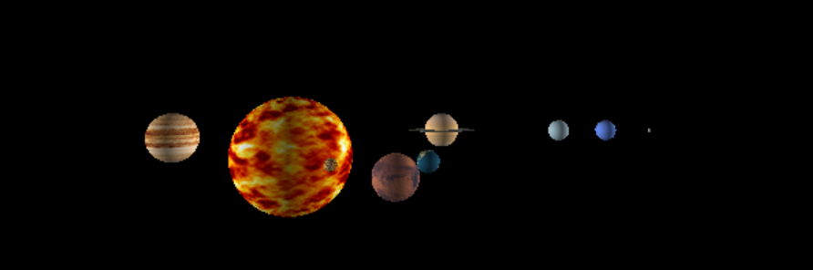
Introduction
It’s a 3D representation of the Solar System using OpenGL and various Graphic Libraries.

Slide 4
Techniques Used
Texture Mapping
Lighting
Navigation with Keyboard and Mouse
Multiple Cameras
User Interaction and KeyFrame Animation

Slide 5
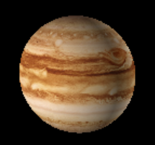
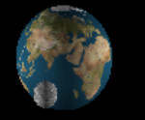
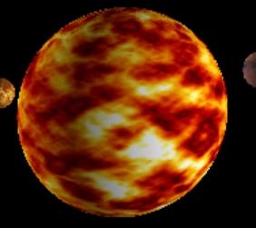
Texture Mapping
Created textures of various planets and bind them to the spheres.
Used SOIL (Simple OpenGL Image Library) to create textures from the bmp
image.

Slide 6
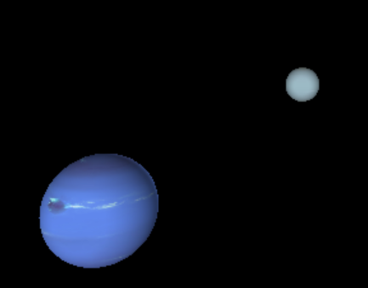
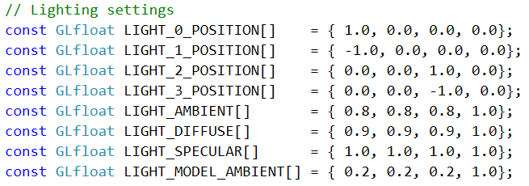
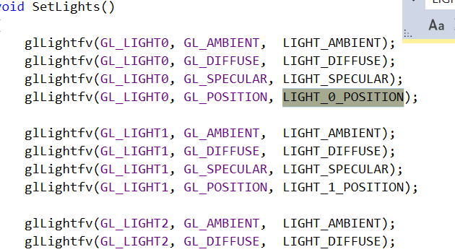
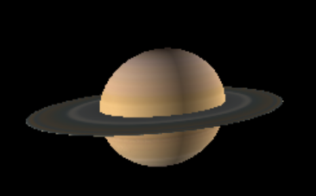
Lighting
Have used multiple light source and can change settings to use different colors in lights.

Slide 7
Navigation
Implemented keyboard and mouse callback functions to have navigation using mouse and keyboard.
Different settings based on different key and mouse buttons.
Ex. Zoom, navigate left, right, up, down.
Can change viewing angle, camera direction, distance from camera etc.

Slide 8
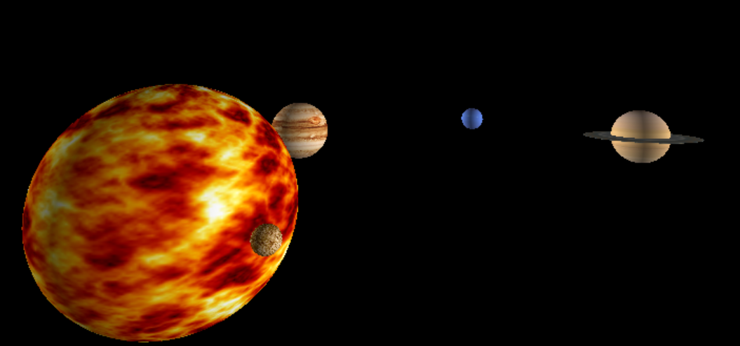
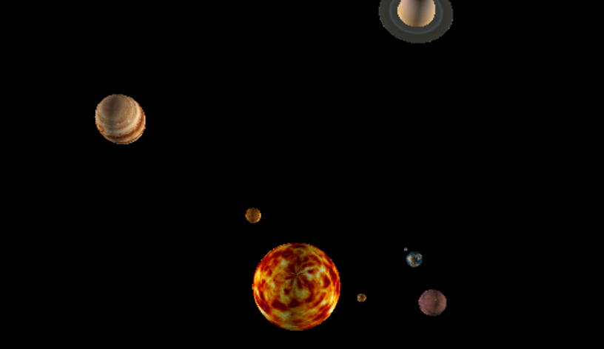
Camera Positions
Used 2 camera positions where we can see the Solar System from 2 different orientations or positions simultaneously or in solar system’s real time.

Slide 9
User Interaction and KeyFrame Animation
We can change the speed of rotation and revolution of planets using keyboard.
Rotation and revolution are relative.
Also can zoom-in/ zoom-out and change camera position using keyboard input.

Slide 10
Improvements
Implement Galaxy
Add/remove Orbit
Spaceships and animation
Go to each planet using mouse click and display details.

